Slide 1
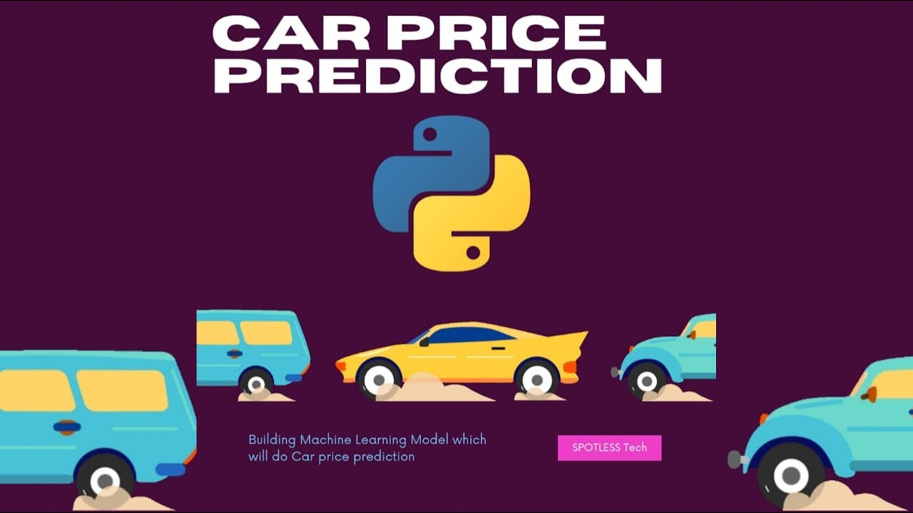
USED CAR PRICE PREDICTION
Presented by:
Akash Pandey

Slide 2
Problem Statement
With the covid 19 impact in the market, we have seen lot of changes in the car market. Now some cars are in demand hence making them costly and some are not in demand hence cheaper. One of our clients works with small traders, who sell used cars. With the change in market due to covid 19 impact, our client is facing problems with their previous car price valuation machine learning models. So, they are looking for new machine learning models from new data. We have to make car price valuation model. This project contains two phase:
1.Data Collection Phase
2.Model Building Phase
Continued…

Slide 3
1.Data Collection Phase:
You have to scrape at least 5000 used cars data. You can scrape more data as well, it’s up to you.
more the data better the model.
In this section You need to scrape the data of used cars from websites (Olx, cardekho, Cars24
etc.) You need web scraping for this. You have to fetch data for different locations. The number of
columns for data doesn’t have limit, it’s up to you and your creativity. Generally, these columns are
Brand, model, variant, manufacturing year, driven kilometers, fuel, number of owners, location and
at last target variable Price of the car. This data is to give you a hint about important variables in
used car model. You can make changes to it, you can add or you can remove some columns, it
completely depends on the website from which you are fetching the data.
Try to include all types of cars in your data for example- SUV, Sedans, Coupe, minivan,
Hatchback.
Note – The data which you are collecting is important to us. Kindly don’t share it on any public platforms.
Continued…

Slide 4
2.Model Building Phase:
After collecting the data, you need to build a machine learning model. Before model building do all
data pre-processing steps. Try different models with different hyper parameters and select the best
model.
Follow the complete life cycle of data science. Include all the steps like.
1. Data Cleaning
2. Exploratory Data Analysis
3. Data Pre-processing
4. Model Building
5. Model Evaluation
6. Selecting the best model.

Slide 5
Data Description
The dataset contains 6224 records (rows) and 10 features (columns).
Here, we will provide a brief description of dataset features. Since the
number of features is 10, we will attach the data description i.e.,
'Model', 'Engine', 'Owner(s)', 'Manufacturing_year', 'Driven_km’,
'Fuel_type', 'Transmission', 'Selling_Price', 'location','Mileage'.

Slide 6
Target Variable
Price(Selling Price): It’s continuous type of data, so the model approach is carried out for Regression analysis.
Regression:
It’s an analysis is used when you want to predict a continuous dependent variable from a number of independent variables.
Independent variables with more than two levels can also be used in regression analysis.

Slide 7
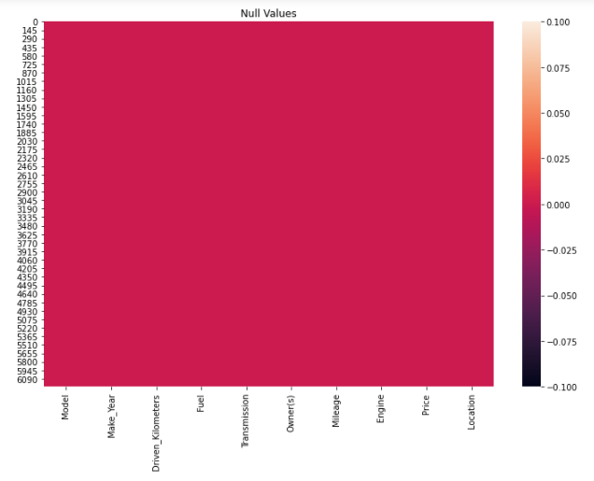

Slide 8
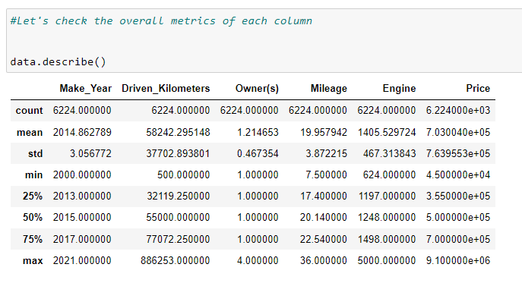
Statistical Summary
To see statistical information about the non-numerical columns in our dataset:

Slide 9
EDA(Exploratory Data Analysis)
Visualization

Slide 10
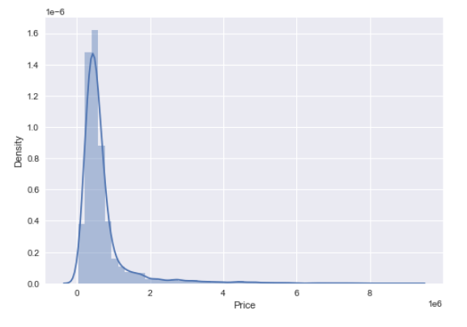

Target Variable (Selling Price)

Slide 11
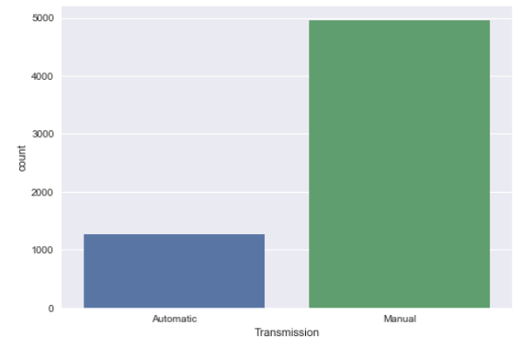
Manual Used Car are mostly available for sale

Slide 12
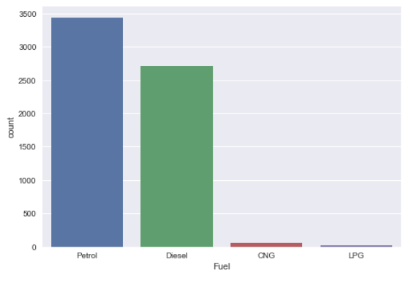
Cars with fuel type “Petrol” and “Diesel” are highly available for sale

Slide 13
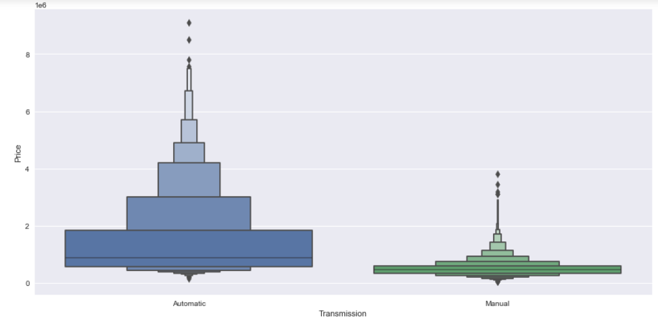
Automatic Car Price is higher when compared to Manual Car transmission Car Price

Slide 14
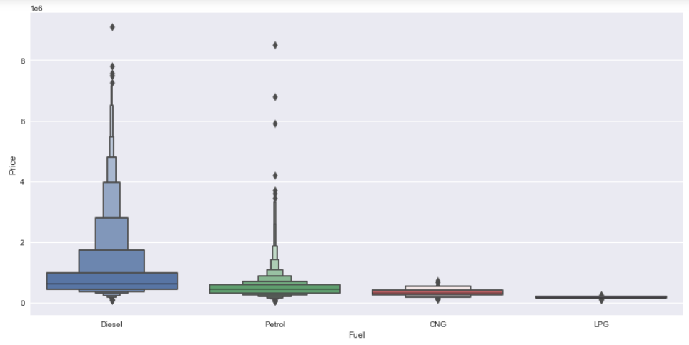
Again Used Cars with fuel type: “Diesel” and “Petrol” are mostly costly

Slide 15
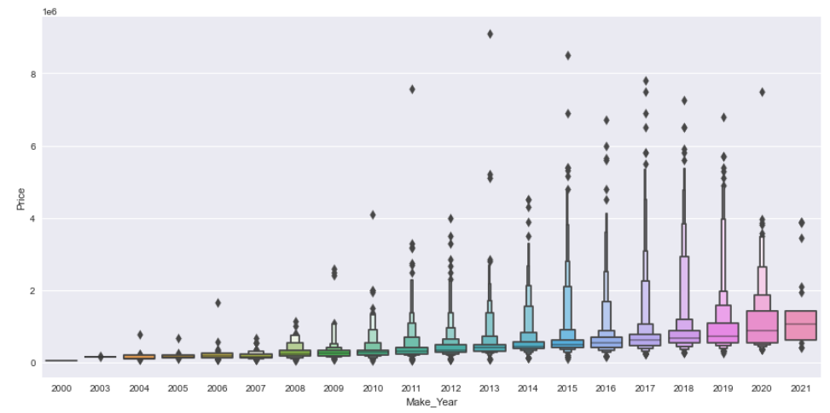
During 2013 - 2017, people were selling the cars with high price, but due to this pandemic (covid-19) the used car sale price is drastically reduced

Slide 16
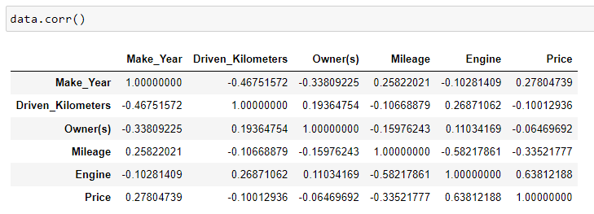
Correlation matrix:
A correlation matrix is simply a table which displays the correlation. The measure is best used in variables that demonstrate a linear relationship between each other. The fit of the data can be visually represented in a heatmap.

Slide 17
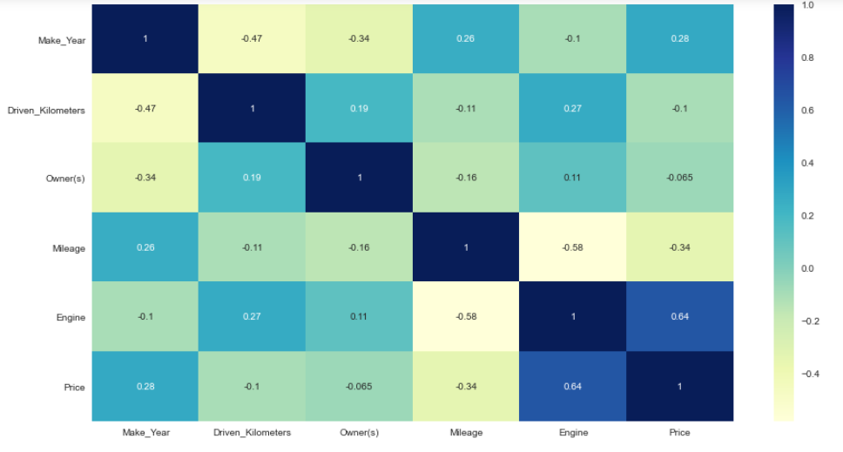
We see that, the largest correlated features are "Engine" and "Price" with correlated values: "0.64" the lowest correlated features are "Owner(s)" and "Price" with correlated values: "-0.065"

Slide 18
Data Pre-processing

Slide 19
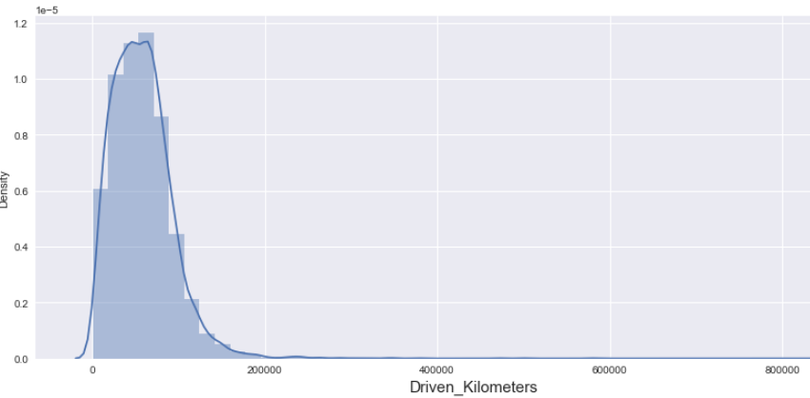
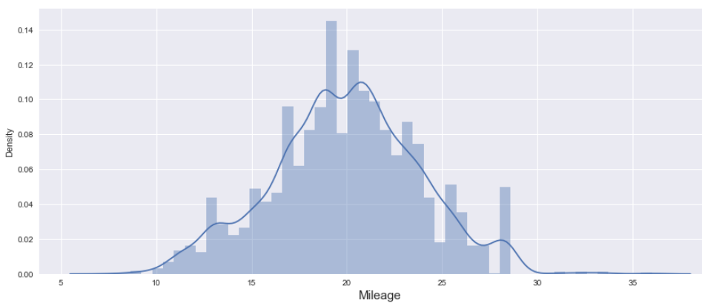
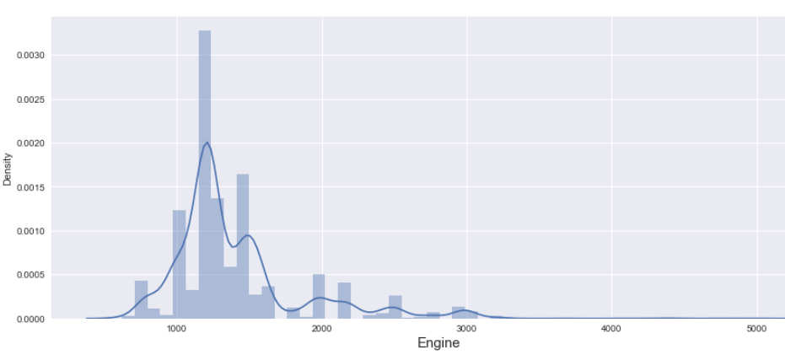
Checking the data distribution among all the columns.

Slide 20
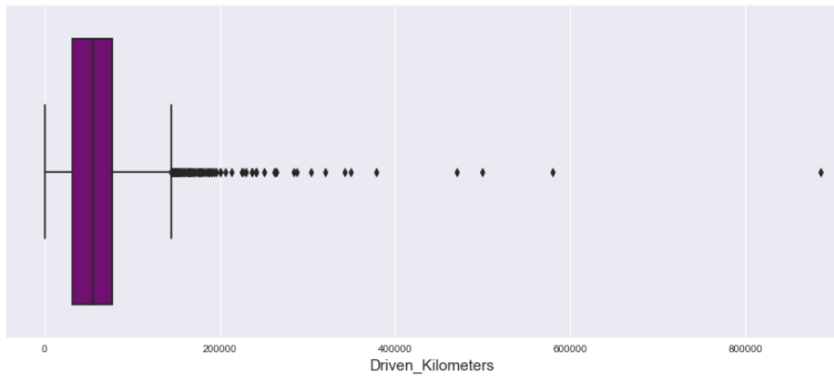
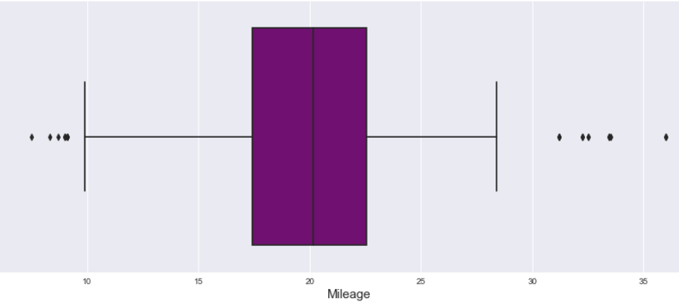
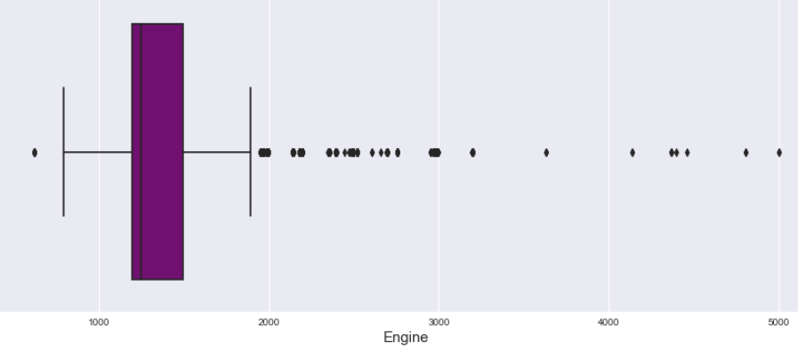

Slide 21
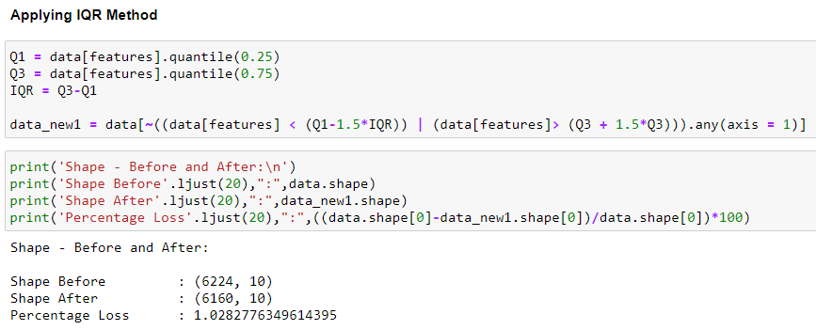
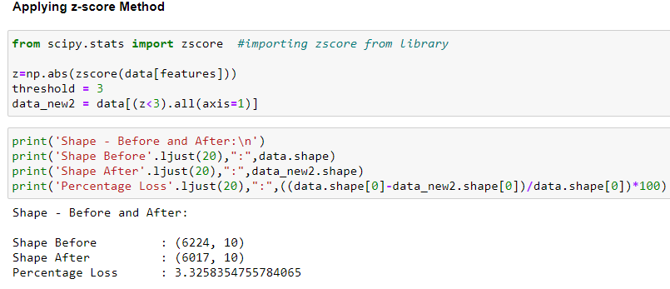
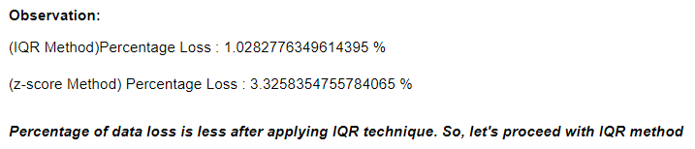
features = ['Driven_Kilometers', 'Mileage', 'Engine'] #columns with outliers by checking the above plots

Slide 22
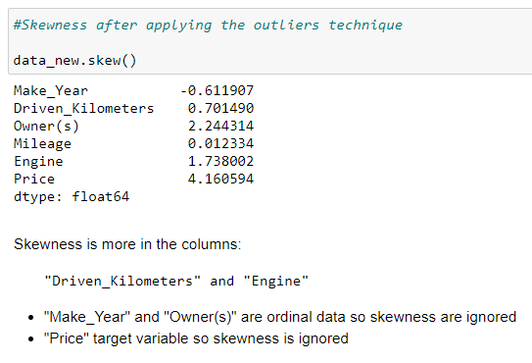
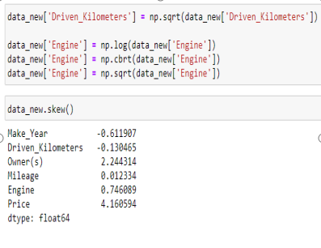

Slide 23
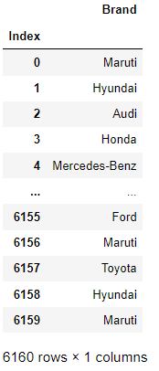
Adding Features in Datasets
Adding new feature “Brand” in data frame
Dropped Features
Models

Slide 24
Encoding the Categorical Columns

Slide 25
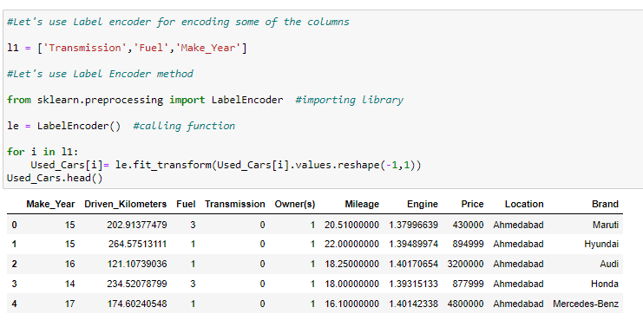

Encoding of Data Frame:
The Encoding Technique is used for this problem:
label encoding technique with multiple variables.
2. Getting Dummies
Firstly, proceed with Label encoding technique with multiple variables for particular features i.e., Brand
Secondly, proceed with getting dummies for location and Brand

Slide 26
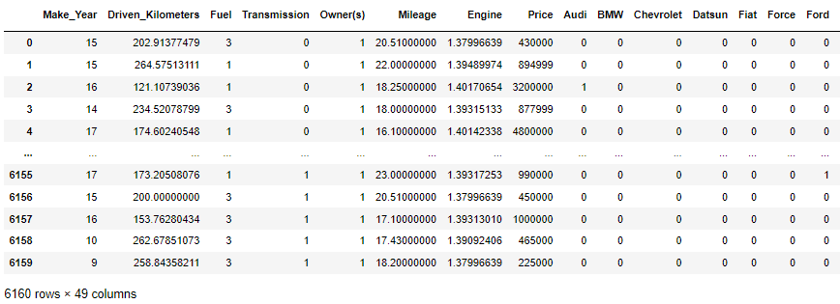
Now, we can see all features is converted into numerical one after proceeding with encoding technique.

Slide 27
MODEL BUILDING

Slide 28
Model Building and Evaluation
These are modelling approach made to build an model :
Random Forest
k-nearest neighbors (KNN)
Decision Tree
Gradient Boosting
Lasso
Ridge

Slide 29
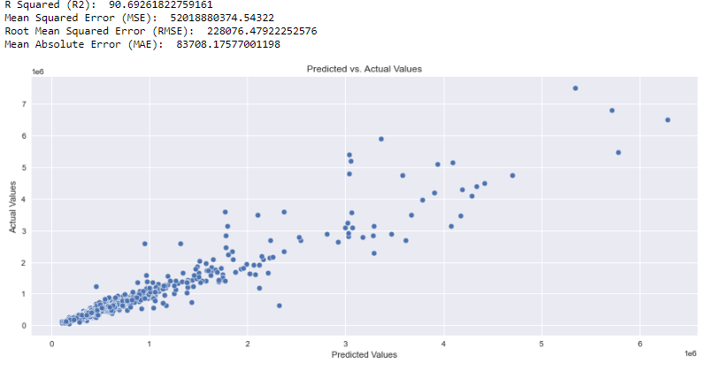
Random Forest Regressor

Slide 30
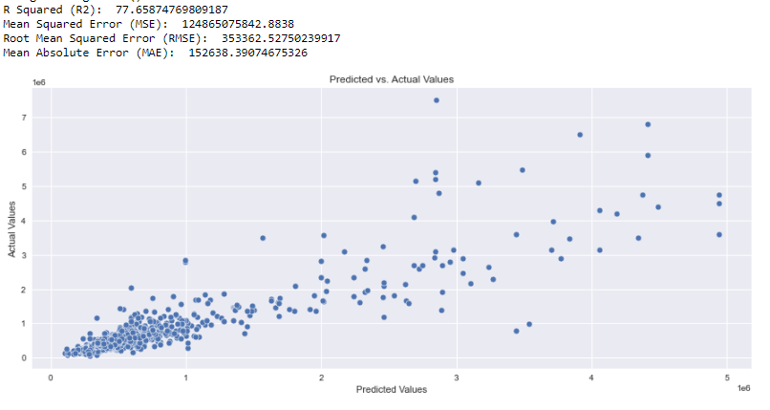
KNeighbors Regressor

Slide 31
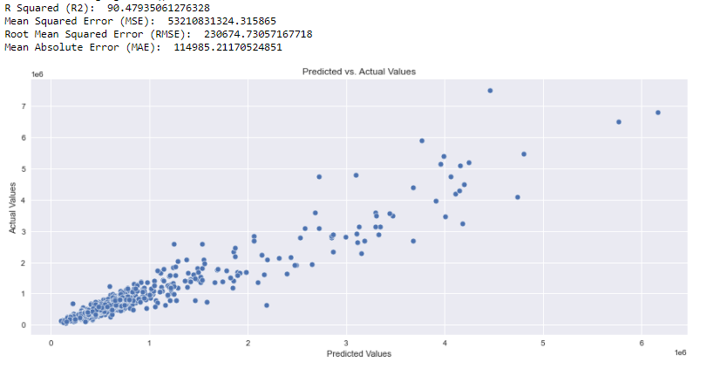
Gradient Boosting Regressor

Slide 32
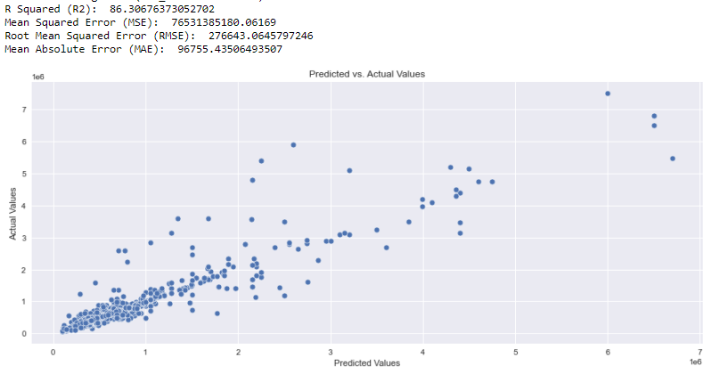
DecisionTreeRegressor

Slide 33
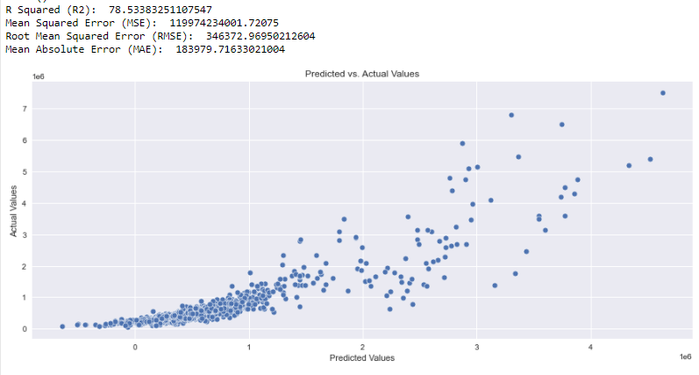
Lasso

Slide 34
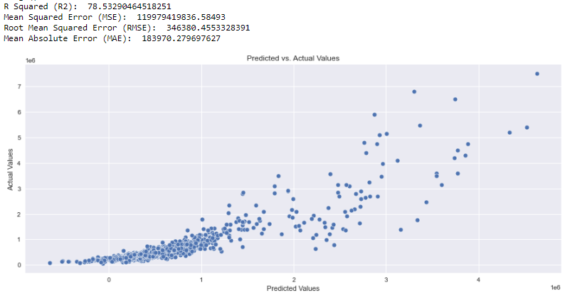
Ridge

Slide 35
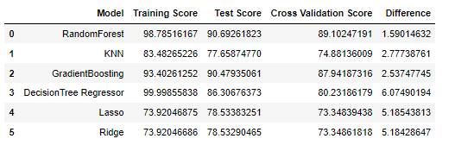
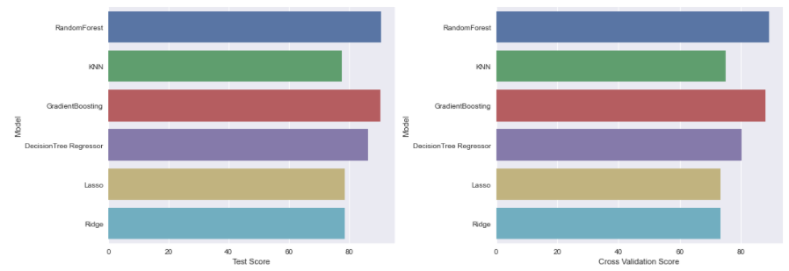
Overview of the scores
According to performance metric, the random forest has higher R2 score, So this is our best model.

Slide 36
Hyper Parameter Tuning
The Hyper parameter tuning is carried out for Random Forest Regressor model.
Because performance metric score is 90.7%.

Slide 37
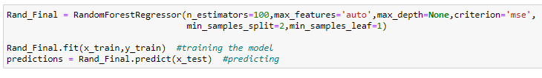

Hyper Parameter Tuning Performance

Slide 38
Best Model
Hyper parameter Tuning performance is carried out for Random Forest Regressor:
Hyper parameter Tuning i.e.,R2 score = 90.83% respectively. Finally, Random Forest Regressor is best model for these dataset.

Slide 39
Conclusion:
In this paper, we built several regression models to predict the selling price of cars by given some of the cars features. We evaluated and compared each model to determine the one with highest performance. We also looked at how some models rank the features according to their importance. In this paper, we followed the data science process starting with getting the data, then cleaning and pre-processing the data, followed by exploring the data and building models, then evaluating the results.
As a recommendation, we advise to use this model (or a version of it trained with more recent data) by car market who want to get an idea about car price. The model can be used also with datasets that covered areas provided that they contain the same features. We also suggest that people take into consideration the features that were deemed as most important as seen in the previous section; this might help them estimate the car price is better.

Slide 40
Thank you

